Slide 1
2023 Swine Reproductive Anatomy
National Junior Swine Association
Skillathon Resource

Slide 2
Learning Outcomes
Identify and label various reproductive structures in sow and boar reproductive tracts
Explain the purpose of reproductive structures to better understand the A.I. and semen collection processes
Understand the importance of correctly reading ultrasounds in sows and semen quality in boars

Slide 3
Why is swine reproduction important?
Reproduction is utilized to create the next generation and capitalizes on genetic opportunities
Various reproductive structures serve different purposes in the field of reproduction
We as producers want to be as efficient as possible, with large litters, as often as possible

Slide 4
Terms to Know!
Estrus: 2–3-day time period where female is receptive to male. ”Heat”
Estrous: 18–24-day cycle (21-day average).
Artificial Insemination: Inserting boar semen into the reproductive tract of a gilt or sow
Spirette: Spiral-shaped plastic insemination rod
Ovulation: Occurs during estrus when female releases 15-24 ova
Gestation: The term for pregnancy, 114 days, or 3 months, 3 weeks, and 3 days
Lactation: The time the mother produces milk for nursing offspring

Slide 5
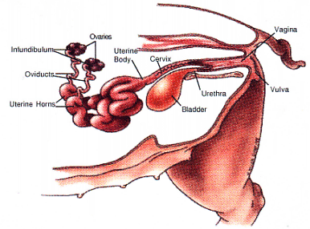
Gilt & Sow Anatomy

Slide 6
Uterine Horns
Female swine have two uterine horns. Each is 2-3 feet in length when the sow is not pregnant (open). The uterine horns are a passageway for sperm to reach the oviduct

Slide 7
Ovaries
Are the main structures of the female reproductive tract and have two functions: produce ova (the female germ cells) and to produce the hormones progesterone and estrogen.

Slide 8
Oviducts
Are the site where fertilization occurs. They are about 6-10 inches long and connect the ovaries to the uterine horns

Slide 9
Cervix
Is the muscle located between the vagina and the uterine body. The cervix is the site where semen is deposited during natural mating and traditional A.I.

Slide 10
Vulva
The external opening of the female reproductive tract. It usually becomes red and swollen during estrus.

Slide 11
Vagina
Connects the vulva to the cervix and serves as a passageway for piglets during farrowing. Also is connected to the bladder and serves as a passageway for urine.

Slide 12
Urethra
The tube that connects the bladder to the vagina to transport urine out of the body

Slide 13
Bladder
The sac that contains and holds urine before it is transported out of the body.

Slide 14
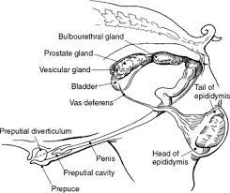
Boar Anatomy

Slide 15
Epididymis
A coiled tube attached to the upper surface of the testicle where sperm is stored. The sperm leaving the epididymis enters the vas deferens.

Slide 16
Scrotum
Is the pliable skin that surrounds the testes that contracts during cold environments and relaxes during hot environments.

Slide 17
Testes
The two structures in which sthe sperm is produced.

Slide 18
Spermatic Cord
Fibrous cord, containing the vas deferens and blood vessels, by which the testicles are suspended.

Slide 19
Vas Deferens
The muscular tube that transports the sperm during ejaculation, from the tail of the epididymis on the testes.

Slide 20
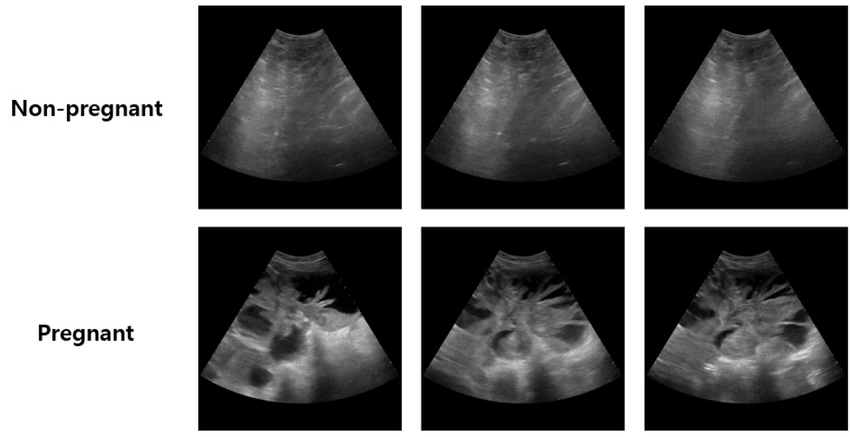
Ultrasounds

Slide 21
Semen Quality
Motility: Normal movement of the sperm cells, Normal >80%
Morphology: Normal shape & structure of the sperm cells, 80-90%
Volume: 200-400 ML per ejaculate or 20 doses/ejaculate
Concentration: Measurement of total sperm cells in the ejaculate, 60-130 billion (3 billion sperm per dose of semen)

Slide 22
Example Questions
Take a brief sample quiz to see what you learned and remembered about swine reproduction!

Slide 23
1. Is this sow ultrasound Bred or Open?

Slide 24
1. Is this sow ultrasound Bred or Open?

Slide 25
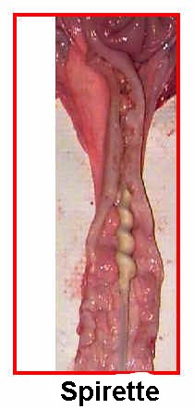
2. Which of the following images represents the ovaries?
A.
B.
C.

Slide 26
2. Which of the following images represents the ovaries?
A. Ovaries
B. Cervix
C. Oviduct

Slide 27
3. What is the correct terminology for inserting boar semen into the reproductive tract of a gilt or sow
Ovulation
Fertilization
Artificial Insemination
Gestation

Slide 28
3. What is the correct terminology for inserting boar semen into the reproductive tract of a gilt or sow
Ovulation
Fertilization
Artificial Insemination
Gestation

Slide 29
4. Which of the following letters represents the testes?
A
B
C

Slide 30
4. Which of the following letters represents the Testes?
A

Slide 31
5. What is the correct terminology for the movement explaining why sperm must swim for fertility?
Morphology
Motility
Concentration
Volume

Slide 32
5. What is the correct terminology for the movement explaining why sperm must swim for fertility?
Morphology
Motility
Concentration
Volume

Slide 33
Great Job! You have completed the “Reproduction” Skillathon Resource! Check out our other resources to become a real expert!

